Slide 1
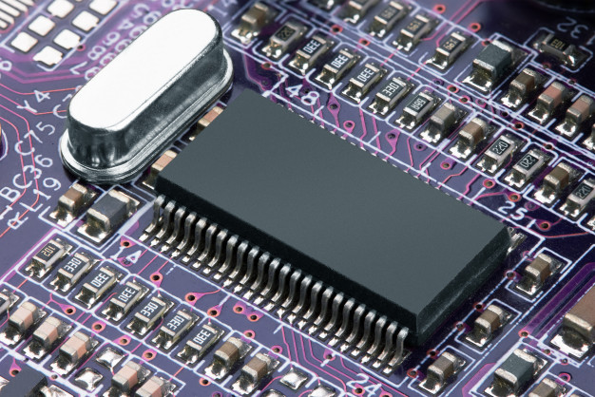

Understanding and Modeling Organizational Systems
CS456: Advanced System Analysis & Design
Session 2
Ferdinand Hiagbe

Slide 2
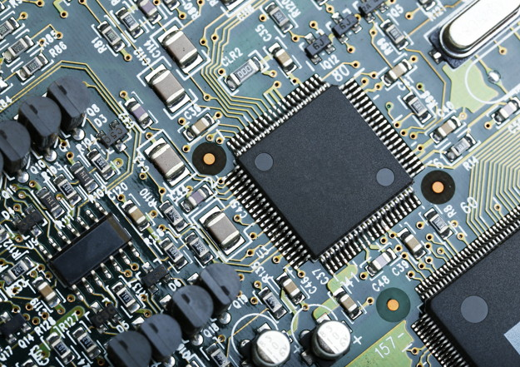

Objectives of this lesson
Depict systems graphically using context-level data flow diagrams, and entity-relationship models, use cases, and use case scenarios.

Slide 3
Major Topics
Depicting systems graphically
Data flow diagram
Entity-relationship model
Use case modeling

Slide 4
Context-level data flow diagrams
Section 1/3

Slide 5
Context-level data flow diagrams
Focus is on the data flowing into and out of the system and the processing of the data
Shows the scope of the system:
What is to be included in the system
The external entities are outside the scope of the system

Slide 6
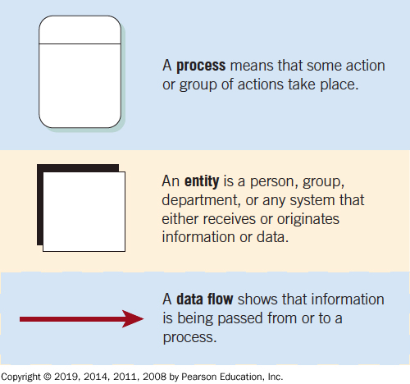
Figure 2.4 The Basic Symbols of a Data Flow Diagram

Slide 7
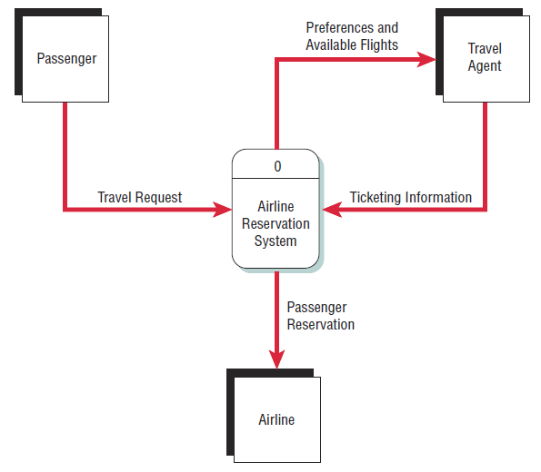
Figure 2.5 Airline Reservation System
A context-level data flow diagram for an airline reservation system

Slide 8
Activities
Create Context-Level Data Flow Diagrams for the following:
A school assignment grading system
A ride hailing app
Mobile Money Platform
MoMo Pay
Pharmacy Sales
Online multishop clothes store
Savings & Loans Transaction platform

Slide 9
Savings & Loans Level 0 DFD
Functions:
Deposits
Request Withdrawal
Register customers
Request for loans
Customer
Request for loan
Record deposit
Susu Agent
0
Savings & Loans System
Deposit money
Record deposits
Register client
Pay monthly

Slide 10
Mobile Money Platform
Functions:
ECG
GWSC
Banks
Shop
DSTV
Momo Merchant
ECG billing system
Shops
Payment
Subscribers
0
GWSC billing system
Payment
MTN Mobile Money Platform
Telco interoperability platform
Give loan
Deposit money
Payment
Withdraw funds
DSTV System
Banks System

Slide 11
Entity-Relationship Model
Section 1/3

Slide 12
Entity-Relationship Model
Focus is on the entities and their relationships within the organizational system
Another way to show the scope of a system

Slide 13
Relationships
Relationships show how the entities are connected
Three types of relationships:
One-to-one
One-to-many
Many-to-many

Slide 14
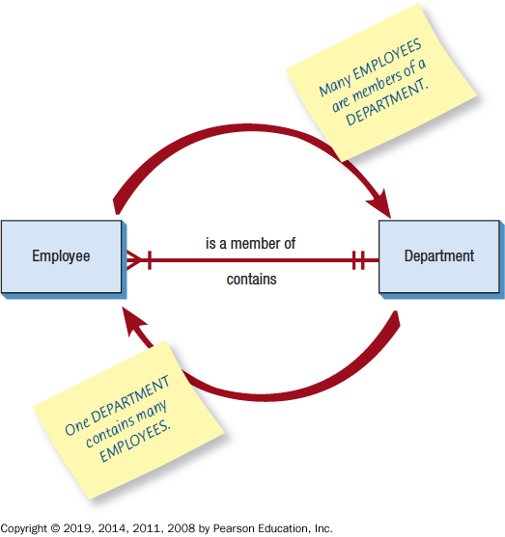
Figure 2.7 Entity-Relationship Example
An entity-relationship diagram showing a many-to-one relationship

Slide 15
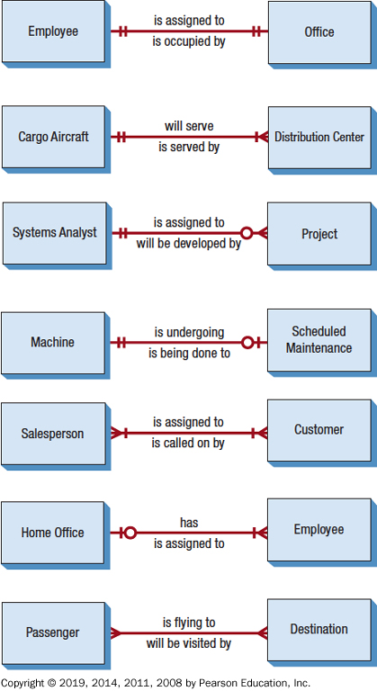
Figure 2.8 Examples of Different Types of Relationships in E-R Diagrams
has
a
b
has

Slide 16
Entities
Fundamental entity
Associative entity
Attributive entity

Slide 17
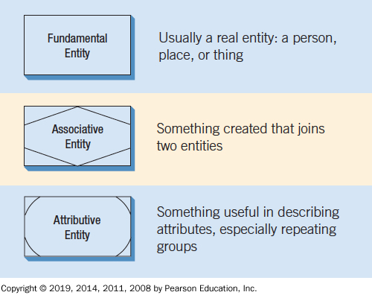
Figure 2.9 Three Different Types of Entities Used in E-R Diagrams

Slide 18
Attributes
Data attributes may be added to the diagram.

Slide 19
Creating Entity-Relationship Diagrams
List the entities in the organization
Choose key entities to narrow the scope of the problem
Identify what the primary entity should be
Confirm the results of the above through data gathering

Slide 20
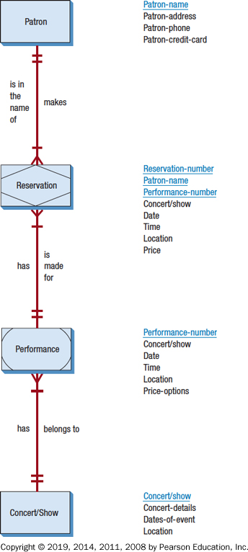
Figure 2.12 A More Complete E-R Diagram Showing Data Attributes of the Entities

Slide 21
Activities
Create E-R Diagrams for the following:
A school assignment grading system
A ride hailing app
Mobile Money Platform
MoMo Pay
Pharmacy Sales
Online multishop clothes store
Savings & Loans Transaction platform
Library Management System

Slide 22
Saving & Loans – ER diagram
Functions:
Deposits
Request Withdrawal
Register customers
Request for loans

Slide 23
Use Case Modeling
Section 1/3

Slide 24
Use Case Modeling
Part of the unified modeling language (U M L)
Describes what a system does without describing how the system works
A view of the system requirements
Analyst works with business experts to develop requirements

Slide 25
Use Case Diagram
Actor
Refers to a particular role of a user of the system
Similar to external entities; they exist outside of the system
Use case symbols
An oval indicating the task of the use case
Connecting lines
Arrows and lines used to diagram behavioral relationships

Slide 26
Actor
Divided into two groups
Primary actors:
Supply data or receive information from the system
Provide details on what the use case should do
Supporting actors:
Help to keep the system running or provide help
The people who run the help desk, the analysts, programmers, and so on

Slide 27
A Use Case Always Provides Three Things
An actor that initiates an event
The event that triggers a use case
The use case that performs the actions triggered by the event

Slide 28
Use Case Relations (1 of 2)
Behavioral relationships
Communicates
Used to connect an actor to a use case
Includes
Describes the situation in which a use case contains behavior that is common to more than one use case

Slide 29
Use Case Relations (2 of 2)
Behavioral relationships [continued]
Extends
Describes the situation in which one use case possesses the behavior that allows the new case to handle a variation or exception from the basic use case
Generalizes
Implies that one thing is more typical than the other thing

Slide 30
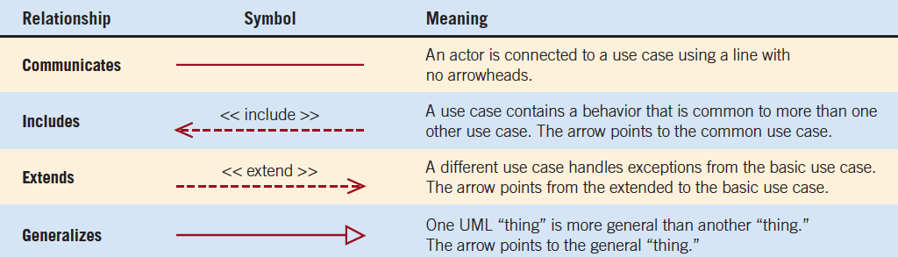
Figure 2.13 Four Types of Behavioral Relationships and the Lines Used to Diagram Each

Slide 31
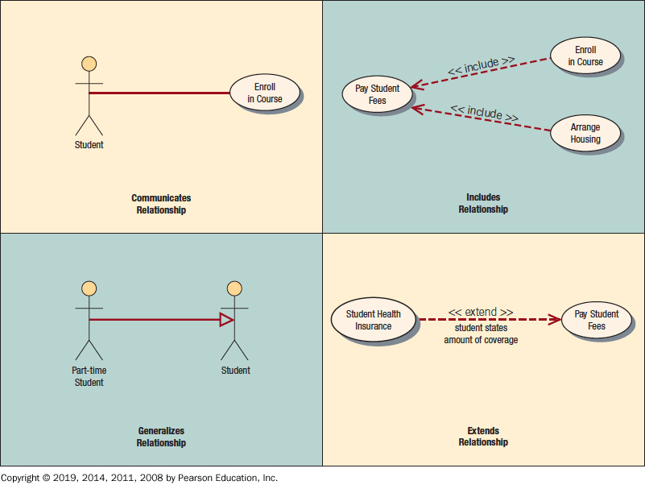
Figure 2.14 Actors, Use Cases, and Relationships for a Student Enrollment Example

Slide 32
Scope
System scope defines its boundaries:
What is in or outside the system
Project has a budget that helps to define scope
Project has a start and an end time
Actors are always outside of scope
Communication lines are the boundaries and define the scope

Slide 33
Developing Use Case Diagrams
Review the business specifications and identify the actors involved
Identify the high-level events and develop the primary use cases that describe those events and how the actors initiate them
Review each primary use case to determine the possible variations of flow through the use case
The context-level data flow diagram could act as a starting point for creating a use case

Slide 34
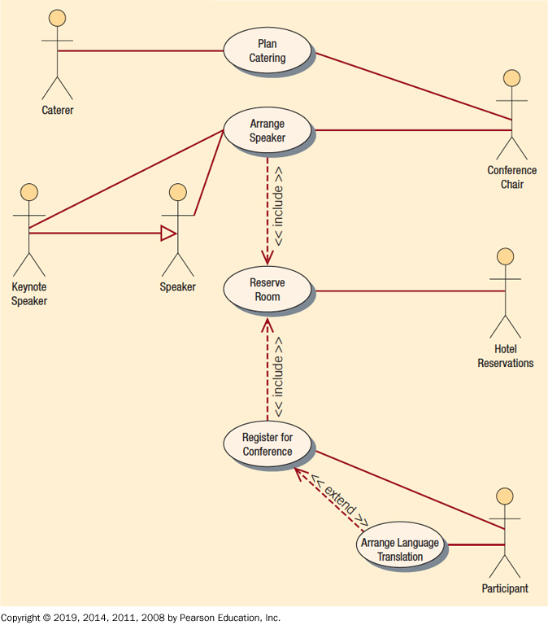
Figure 2.15 A Use Case Diagram Representing a System Used to Plan a Conference

Slide 35
Activities
Create Use Case Diagrams for the following:
A school assignment grading system
A ride hailing app
Mobile Money Platform
MoMo Pay
Pharmacy Sales
Online multishop clothes store
Savings & Loans Transaction platform
Library Management System

Slide 36
Savings & Loans Use Case
Savings & Loans Management System
Register Customer
Agent
Record Deposit
Request payment
Customer
Make payment
Request loan
Process loan
<<includes>>
Clerk
ATM:
Make Deposit
Withdraw Money
Check Balance
Change PIN
Get Mini Statement
Transfer Money
Replenish Money
Generate Reports
Repay loan
Approve/Reject loan
Login
Manager
Verb (first person singular) + Noun

Slide 37
Developing Use Case Diagrams
The description of the use case
Three main areas:
Use case identifiers and initiators
Steps performed
Conditions, assumptions, and questions

Slide 38
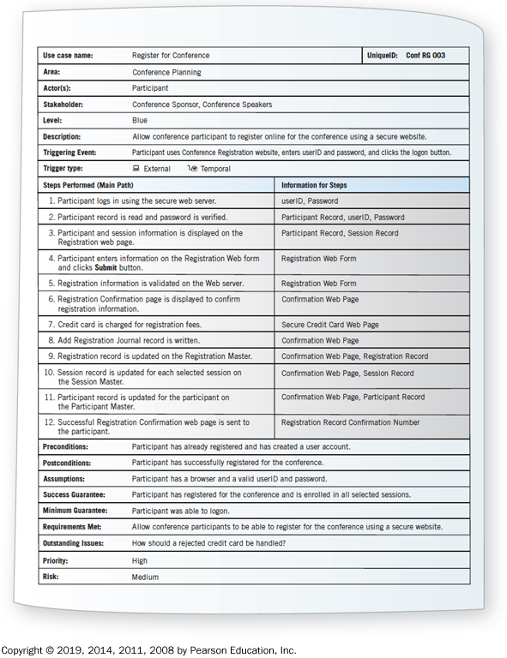
Figure 2.16 A Use Case Scenario is Divided into Three Sections
Name of Use Case: Make Payment
Actor(s): Clerk
Stakeholder(s): Customer, Clerk
Description: This use case is meant to explain how a clerk will make payment for customers who have requested for saved funds to be released after a period of time.
Steps:
Precondition: 1. Customer must have an active account
2. Customer must have saved at least 30 consecutive days to receive payment
Post Condition: 1. Customer balance must be updated
2. System must be ready to records another transaction
Risk:
Priority:
# | Actions | Remarks
1 | Logon into the system
2 | View all payment requests from savings clients
3 | Select a request
4 | Check funds balance and eligibility | Requested funds must less than saved funds.
5 | Click on pay button to make payment

Slide 39
Use Case Header Area
Has a name and a unique I D
Include application area
List actors
Include stakeholders
Include the level
Has a brief description of the use case

Slide 40
Use Case Levels
Use case levels describe how global or detailed the use case description is:
White (like clouds): enterprise level
Kite: business unit or department level
Blue (sea level): user goals
Indigo (or fish): functional or subfunctional
Black (or clam): most detailed

Slide 41
Use Case Footer Area
Preconditions—need to be met before use case can be performed
Postconditions or the state of the system after the use case has finished
Assumptions
Minimal guarantee
Success guarantee
Outstanding issues
Optional priority and risk

Slide 42
Activities
Create Use Case Scenarios for the following:
A school assignment grading system
A ride hailing app
Mobile Money Platform
MoMo Pay
Pharmacy Sales
Online multishop clothes store
Savings & Loans Transaction platform
Library Management System

Slide 43
Four Steps Used to Create Use Cases
Use agile stories, problem definition objectives, user requirements, or a features list
Ask about the tasks that must be done
Determine if there are any iterative or looping actions
The use case ends when the customer goal is complete

Slide 44
Why Use Case Diagrams Are Helpful
Identify all the actors in the problem domain
Actions that need to be completed are also clearly shown on the use case diagram
The use case scenario is also worthwhile
Simplicity and lack of technical detail

Slide 45
Figure 2.18 The Main Reasons for Writing Use Cases are Their Effectiveness in Communicating with Users and Their Capturing of User Stories
Use cases effectively communicate systems requirements because the diagrams are kept simple.
Use cases allow people to tell stories.
Use case stories make sense to nontechnical people.
Use cases do not depend on a special language.
Use cases can describe most functional requirements (such as interactions between actors and applications).
Use cases can describe nonfunctional requirements (such as performance and maintainability) through the use of stereotypes.
Use cases help analysts define boundaries.
Use cases can be traceable, allowing analysts to identify links between use cases and other design and documentation tools.

Slide 46
Q&A
Ferdinand Hiagbe

